Slide 1







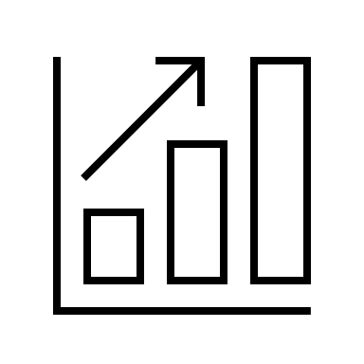
CASE STUDY: Driving Technology Transformation and Governance Through Enterprise Architecture at United Airlines
PROBLEM STATEMENT: United Airlines, a leading airline carrier, faces increasing demands for digital modernization to maintain competitive advantage, ensure operational reliability, and deliver superior user experiences. With a fragmented technology landscape, aging legacy systems, inconsistent architecture standards, and growing complexity in IT infrastructure, there was a pressing need to drive organization-wide standardization, technology adoption, and system reliability, all the while maintaining governance across a vast and dynamic IT landscape.
OBJECTIVES
SOLUTION
IMPACT
PROCESS
DELIVERED
Improve system reliability by assessing and optimizing existing and underperforming applications
Boosted system reliability through detailed assessments and mitigation strategies
Adopted a decentralized, agile engagement methodology across multiple teams
Introduced and implemented AWS QuickSight for analytics
Adopted Kong API platform and Solace messaging system
Retired legacy tools and supported transition to modern, scalable platforms
Delivered implementation guidelines and technology onboarding support
Improved design governance across TechOps, supply chain, and development teams
OPTIMIZED SYSTEM RELIABILITY
Drive scalable adoption of modern tech (e.g. AWS QuickSight, Kong API, Solace)
Conducted 2-3 architecture and cyber security reviews weekly to ensure compliance
Achieved cost savings by retiring outdated tools and reducing system complexity
ENABLED COST SAVINGS
Led application reliability deep-dives, including root cause analysis of reliability/outage issues
Provide architectural guidance and design reviews to ensure system consistency and security
Strengthened enterprise-wide architecture governance and standardization
Supported technology modernization through reviews, guidance, and documentation
IMPROVED GOVERNANCE & STANDARDIZATION
Enable cost-savings through standardization and governance
Acted as an on-demand architecture advisory layer for multiple teams
Accelerated new technology adoption across teams with scalable platforms
TECHNOLOGY MODERNIZATION
Positioned United for future growth with a robust and resilient enterprise architecture foundation
GROWTH FOCUSED

